Slide 1
“It's hard to save the world when you can't save yourself” – Carrie Jones.

Slide 2
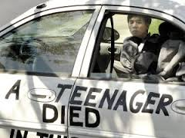
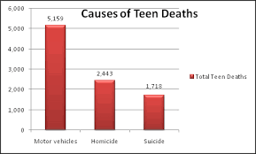

Slide 3
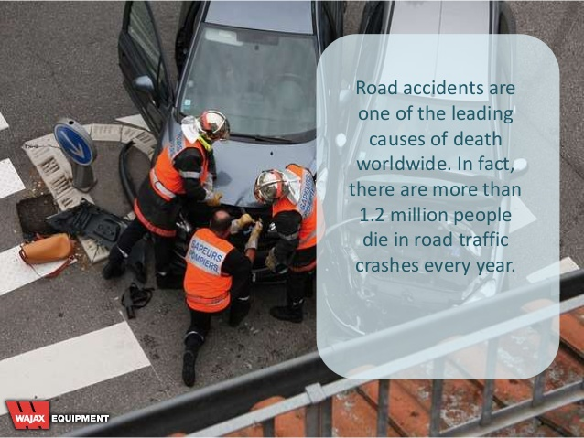

Slide 4
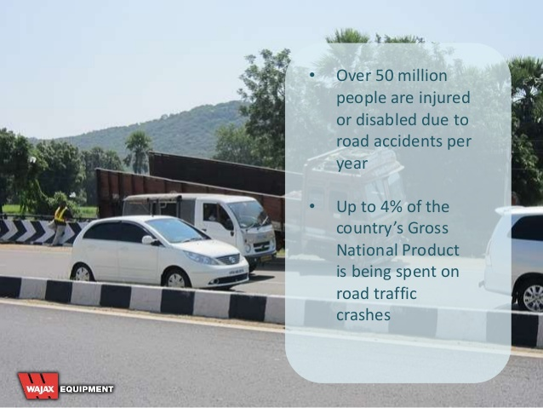

Slide 5
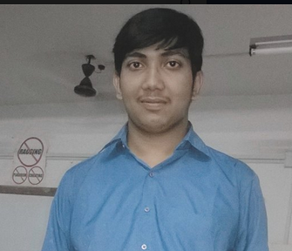
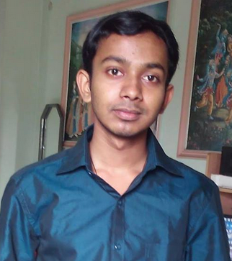
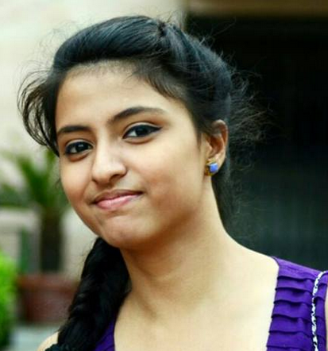
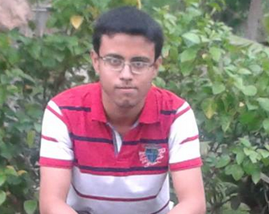
TEAM MEMBERS
DEBOJYOTI DEY.
ABHISHEK SARKAR.
SHRAMONA CHAKRABORTY.
SUBHAM SAHA.

Slide 6
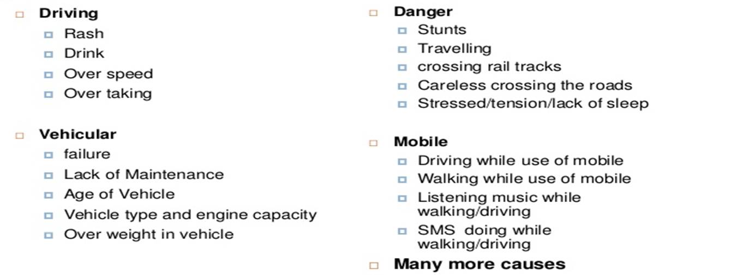
Causes of Road Accidents

Slide 7
Solution our System Provides
Collisions at junctions include rear-end collision and angle or side impacts.
Collisons when long haul drivers fall asleep while driving.

Slide 8
Description 0f
proposed model
&
TECHNOLOGY USED

Slide 9
UNIT 2
Android
Phone
Web Server
UNIT 1
Microcontroller
(Arduino UNO)
Sensor Rendering
Alarm
Raised
Steering & Gear Box

Slide 10
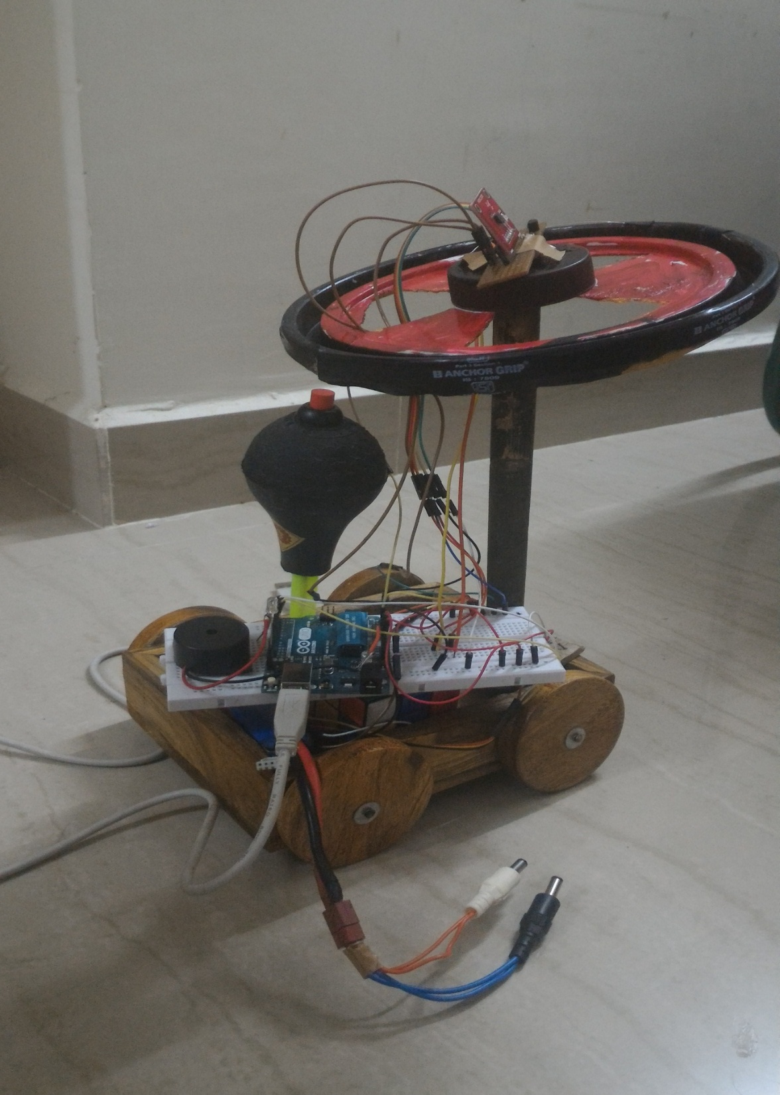
UNIT 1

Slide 11
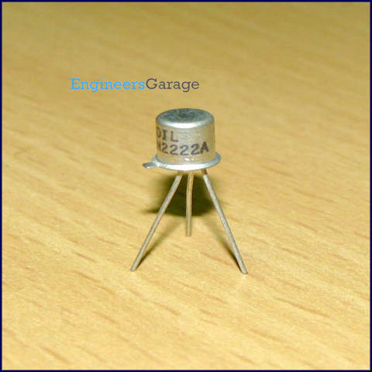
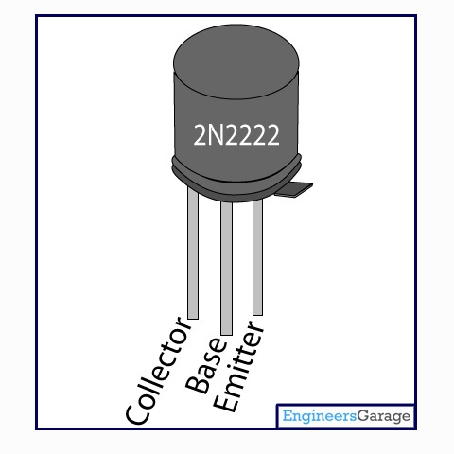
TOUCH SENSOR USING 2N2222 DIODE
PIN DIAGRAM
How it works

Slide 12
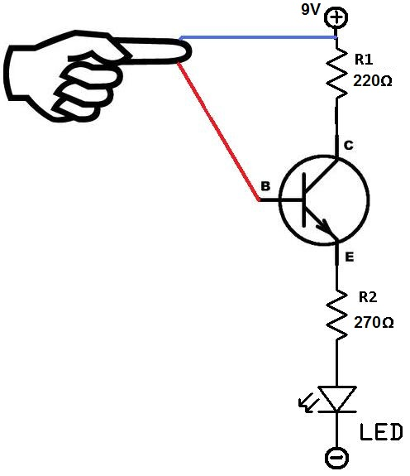
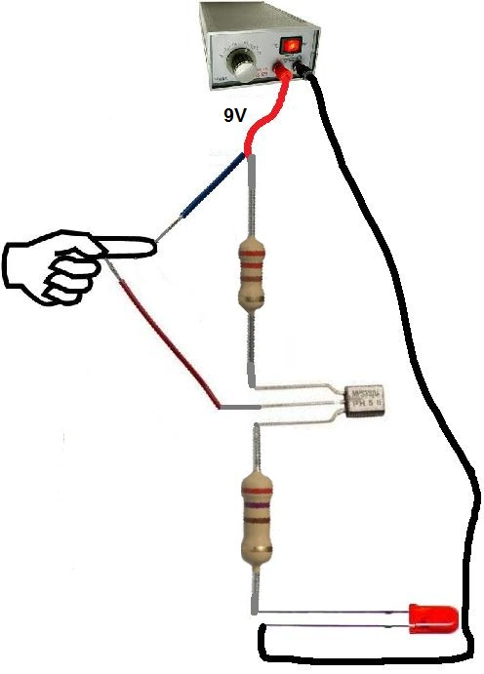

Slide 13
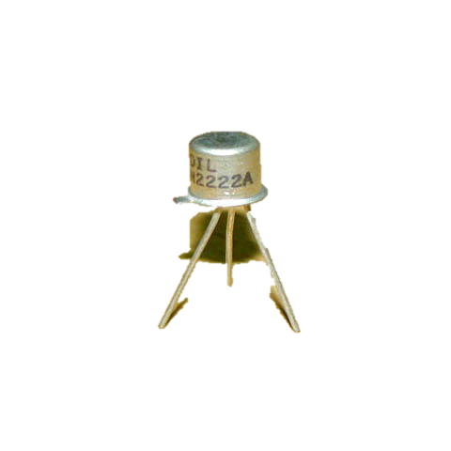
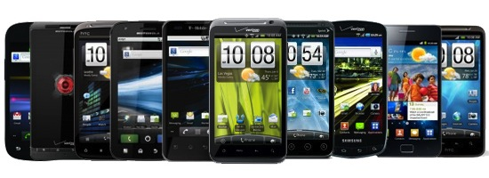
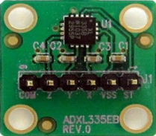
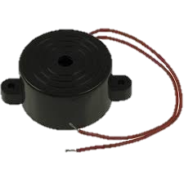
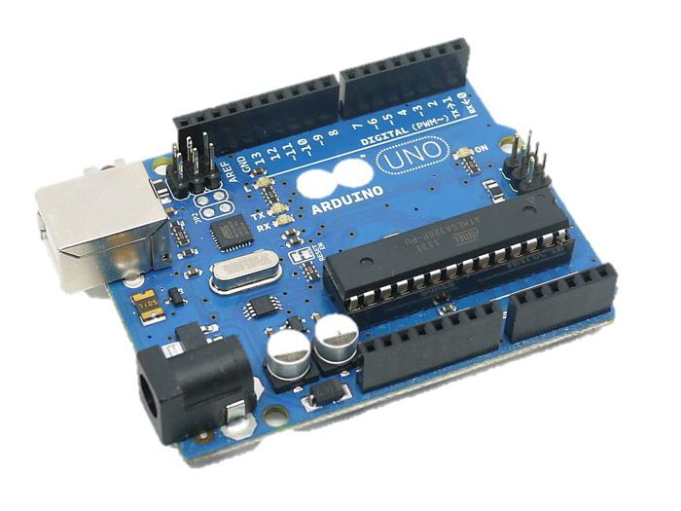
EYE BLINK DETECTION UNIT
GEAR UNIT
+
+
Transistor
Current flow for
Completion of
circuit
STEERING UNIT
Accelerometer
Getting the X,Y & Z
co-ordinates
Transistor
Current flow for
Completion of circuit

Slide 14
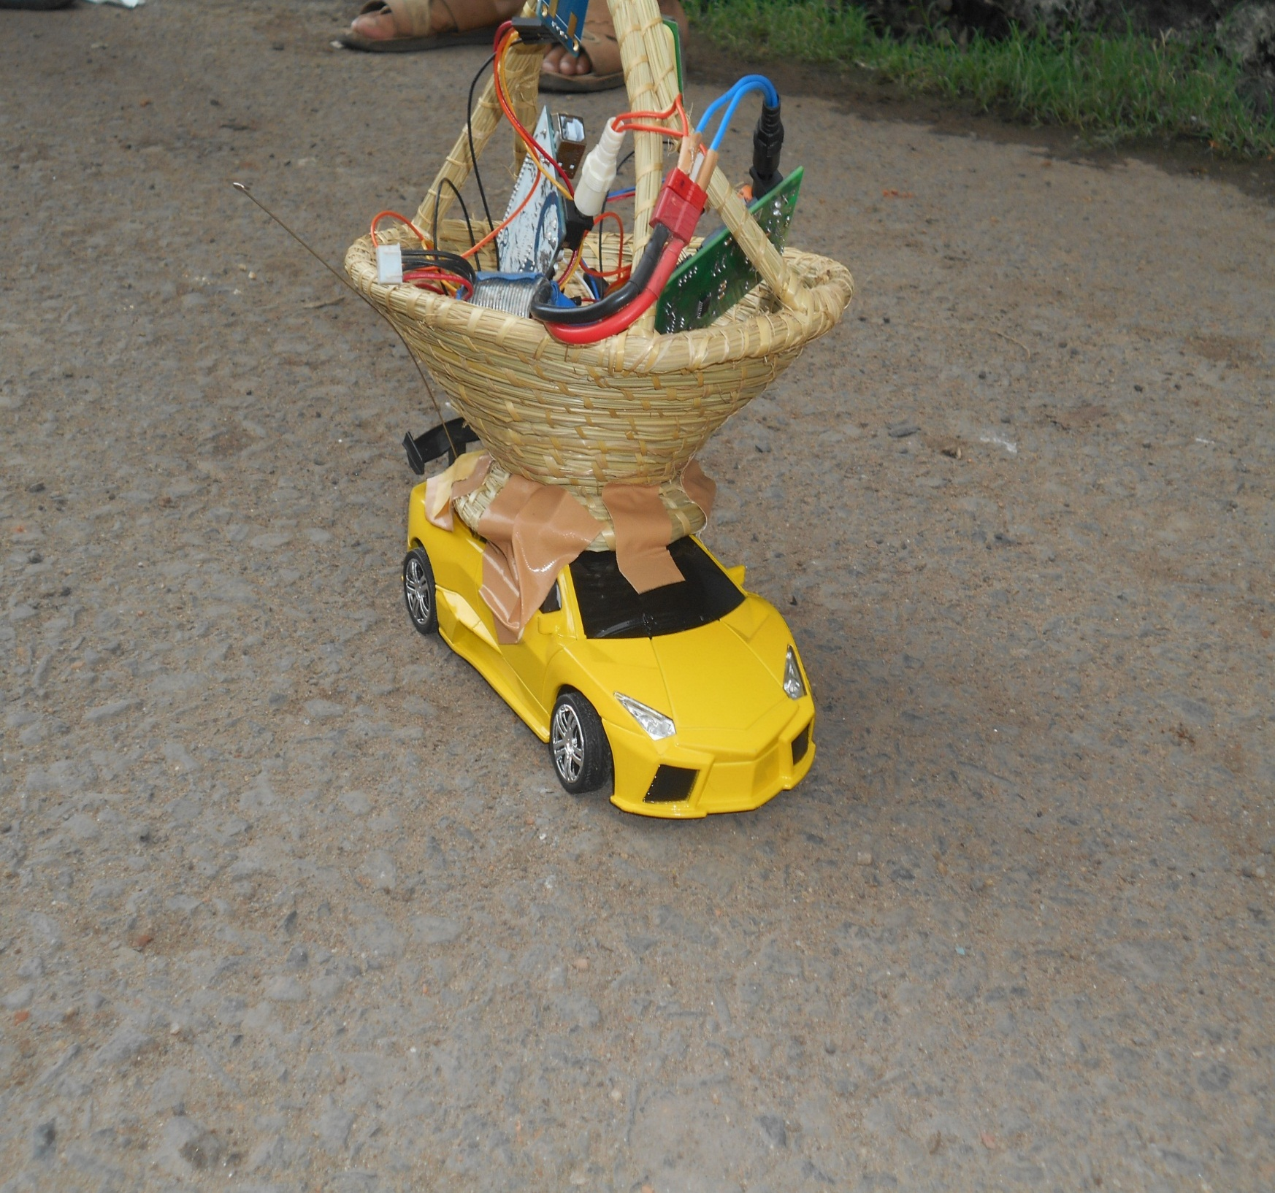
UNIT 2

Slide 15

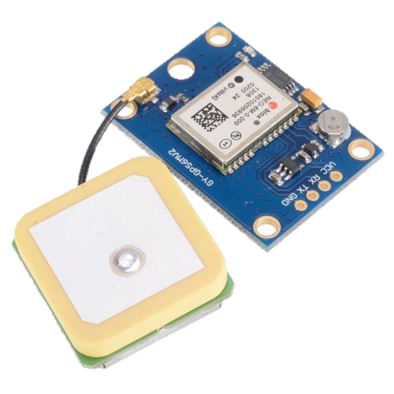
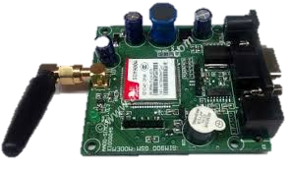
SERVER
+
ANDROID PHONE
+
Arduino UNO
Microcontroller used
for processing the data
ARDUINO
Text to Speech on android
GPS SENSOR
GSM SENSOR
GPS to
Send latitude
and longitude
GSM to send
value to the
server

Slide 16
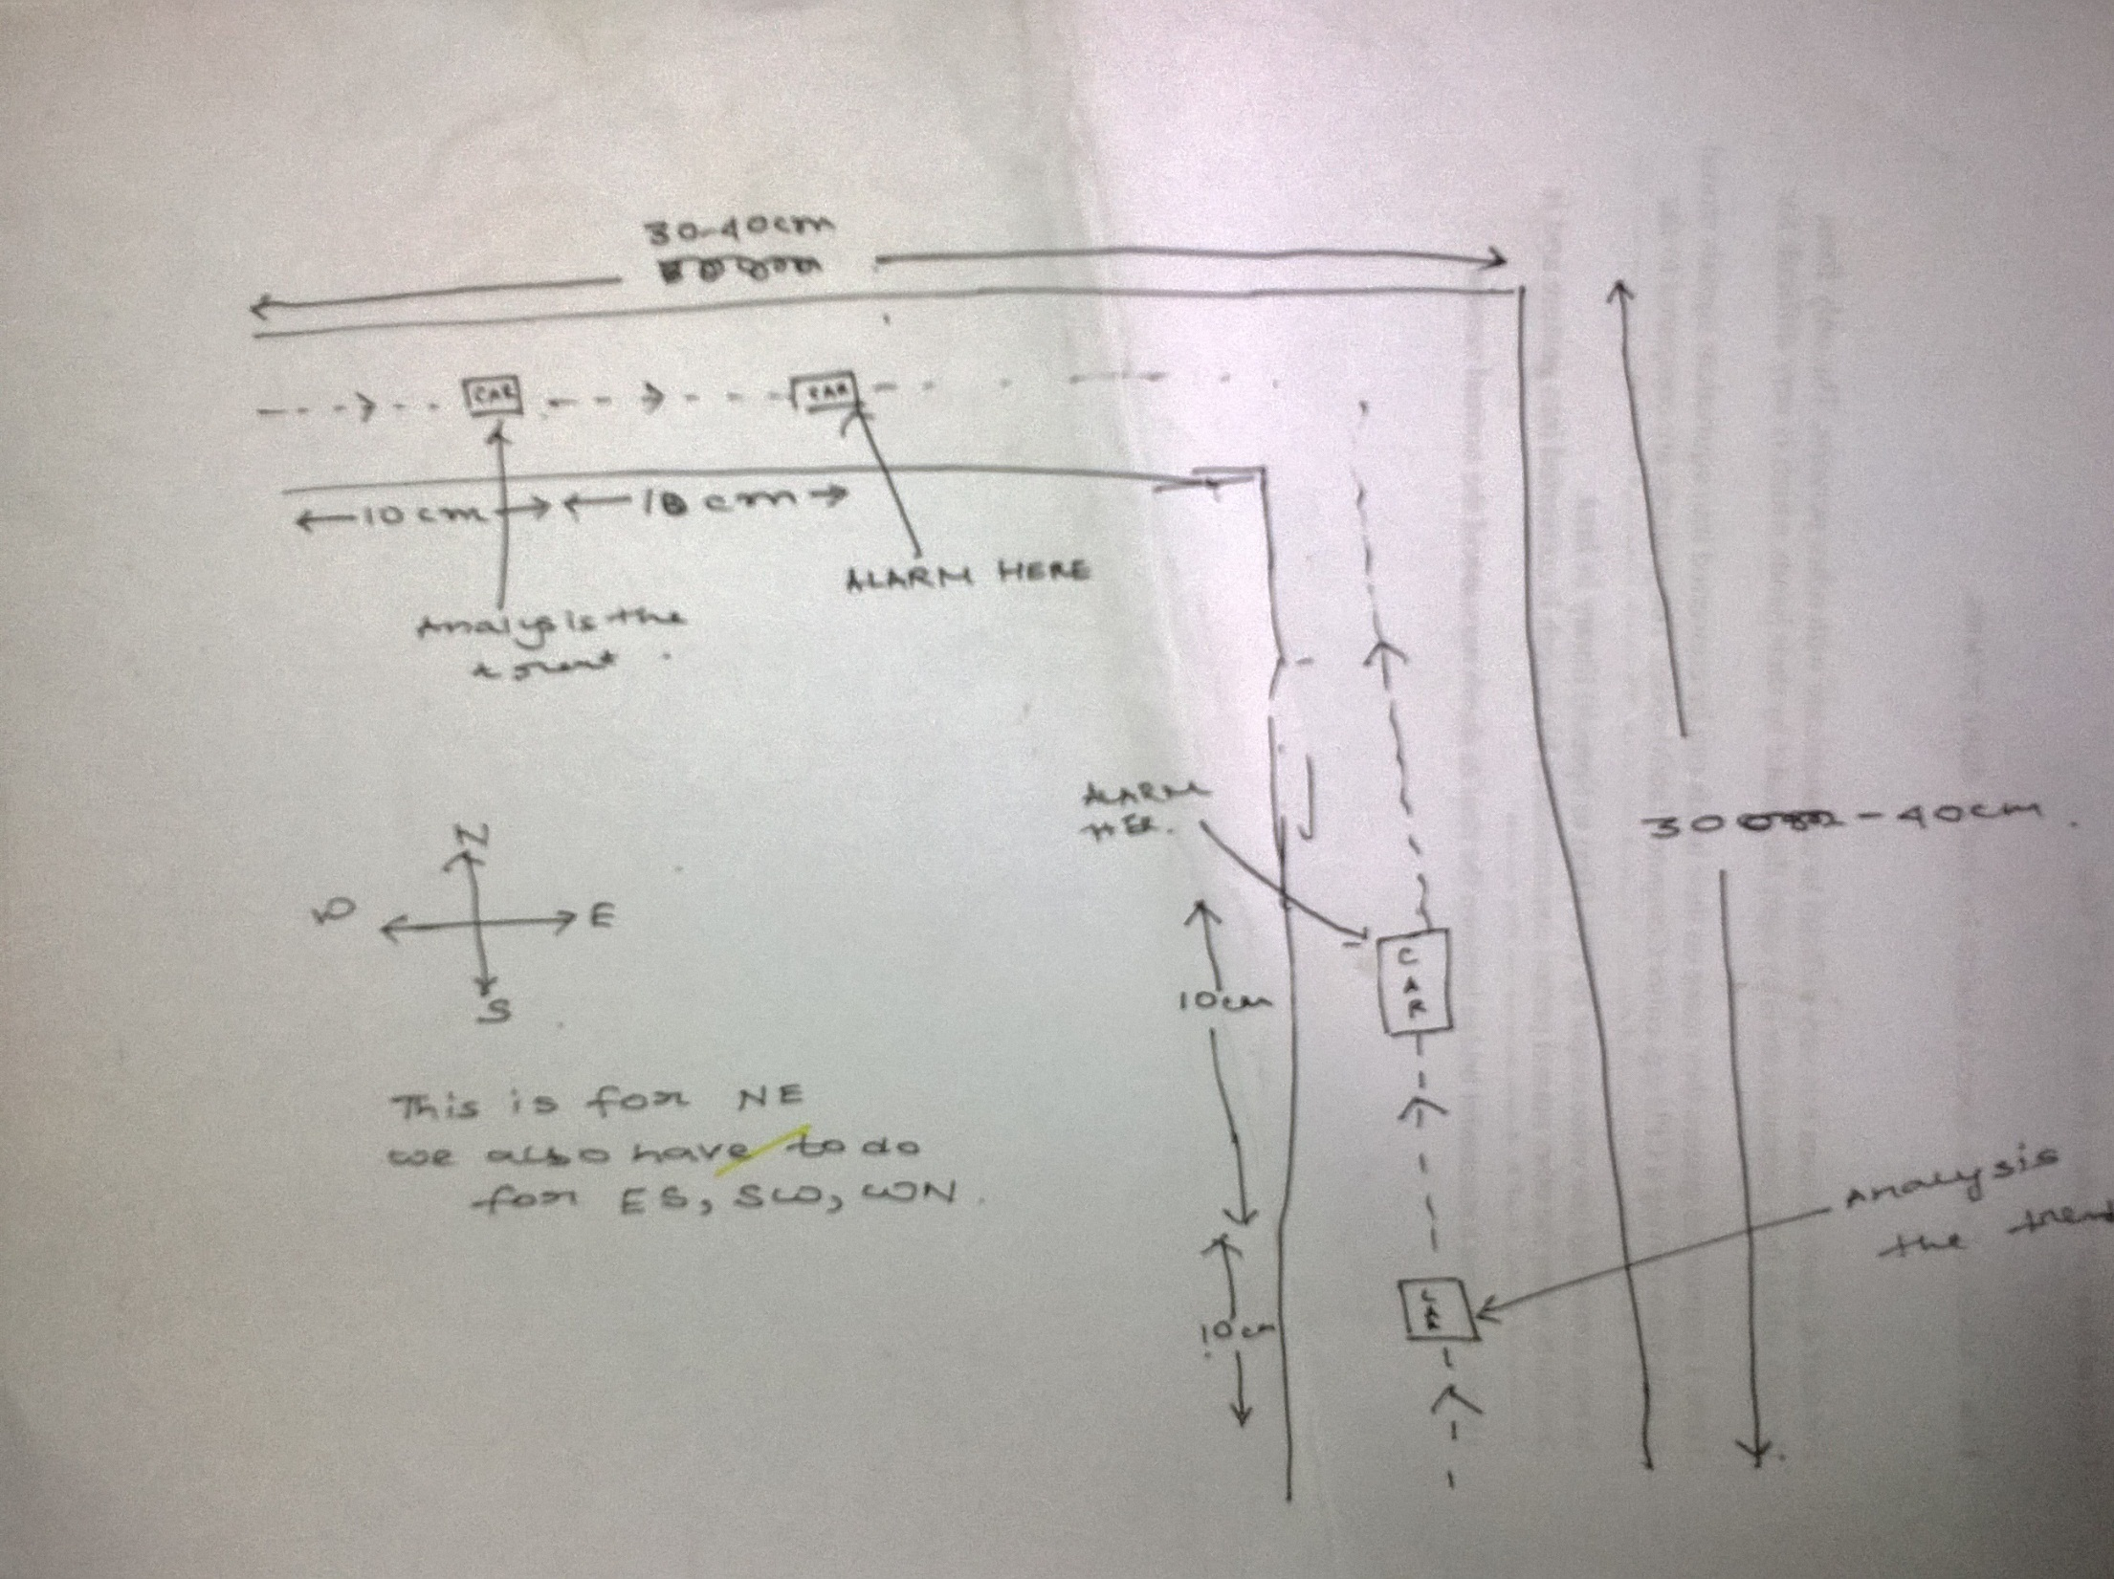

Slide 17
Budget
Sr. No. | Item Name | Price
1. | Arduino UNO | Rs 1400/-
2. | GPS module | Rs 1450/-
3. | GSM Module | Rs 1000/-
4. | ADXL 335 Module | Rs 450/-
5. | Touch Sensor | Rs 50
 | TOTAL | Rs 4350/-

Slide 18
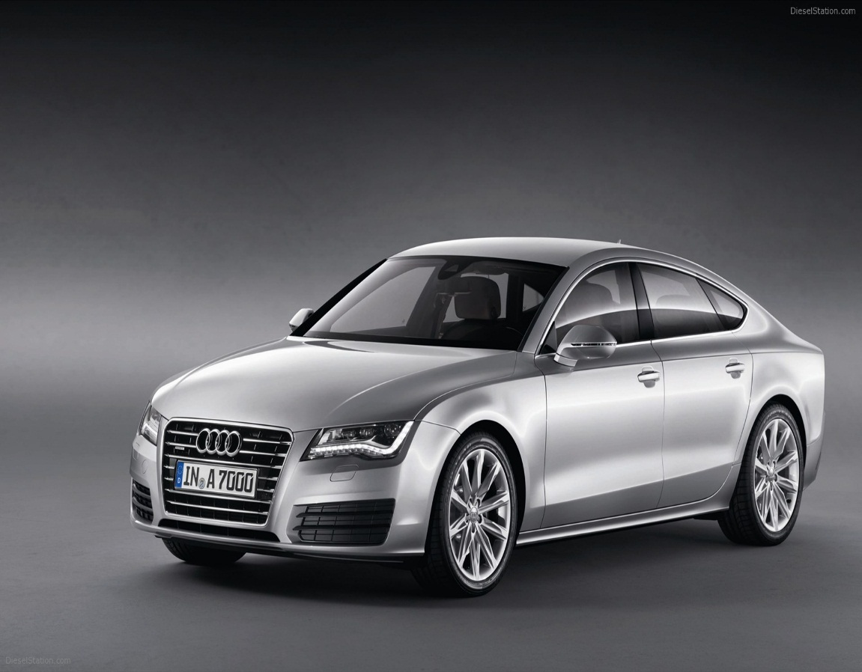
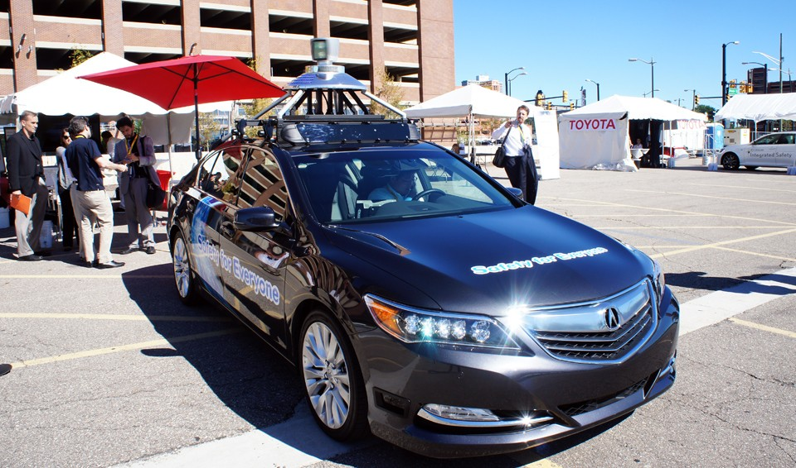
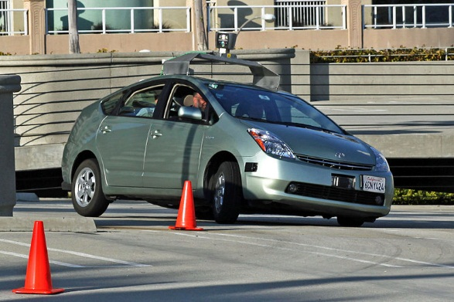
Audi A7 (PILOTED) Rs.88.5 lacs
Toyota Prius
Rs. 39 lacs
Honda Acura Rs. 28 lacs

Slide 19
total cost
8 thousand
INFRASTRUCTURE
ELECTRIC
SUPPLY
TAX
EMPLOYEES
OTHER
ARRANGEMENTS
100 more sedans
20-36
Lakhs
profit
PRODUCTION
ONE FACTORY IS ENOUGH

Slide 20
Distribution of profit amount
V
A
T
T
model

Slide 21
PROFIT
ADVERTISEMENT
TARGET
CONSUMER
TARGET
AREAS
VIABILITY

Slide 22

CNN IBN | Rate/10sec Rs.
7-9 am | 743
9-12 noon | 743
12-7 pm | 743
7-8 pm | 1487
8-11 pm | 1735
Roughly, CNN IBN will charge 5000 approx. all the day for 20seconds and so on.

Slide 23

Aaj Tak | Rate/ 10sec Rs.
7-9 am | 3350
9-12 noon | 2996
12-7 pm | 2746
7-8 pm | 4744
8-11 pm | 10362
Roughly, AAJ TAK will charge 9000 approx. till 8pm for 20 seconds

Slide 24
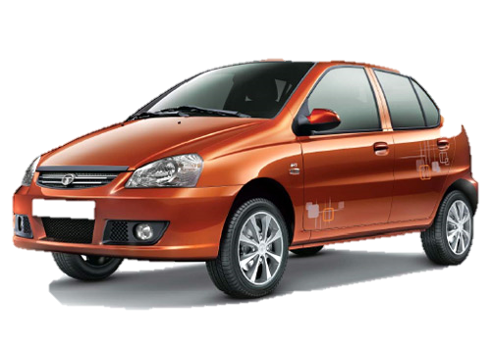
TATA INDICA V2
4.4 LAKHS
Our system gets attached
4.4 lakhs + 8 thousands
equals 4.5 lakhs
PROFIT (March 2015’s record) = 4.54%
Cost changes to
Rs.4,70,430

Slide 25
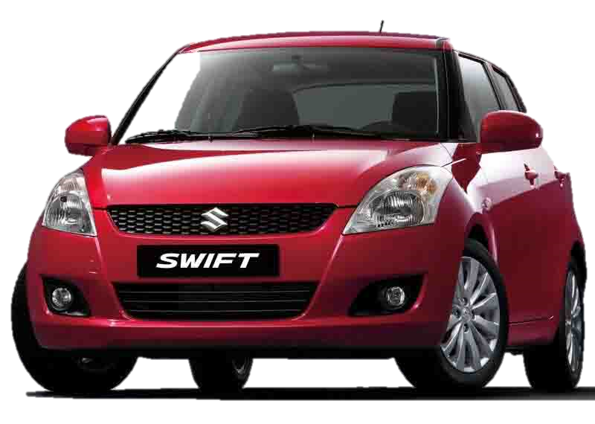
MARUTI SUZUKI SWIFT
5.02 LAKHS
Our system gets attached
5.02 lakhs + 8 thousands
equals 5.1 lakhs
PROFIT (March 2015’s record) =7%
Cost changes to
Rs.5,45,700

Slide 26
If we implement our system in 100 more cars
CAR
SERIES
TATA INDICA V2
MARUTI SUZUKI SWIFT
total costing without profit = Rs.4,50,00,000
total costing with profit = Rs.4,70,43,000
Hence, we are earning
Rs.20,43,000 i.e. 20.5 lakhs approx. for every 100 TATA INDICA V2 with our proposed system only.
total costing without profit = Rs.5,10,00,000
total costing with profit = Rs.5,45,70,000
Hence, we are earning Rs.35,70,000 i.e. 36lakhs approx. for every 100 MARUTI SUZUKI SWIFT with our proposed system only.

Slide 27
Presence of the system in every automobile
Driver should have android phone with the app installed
Mandatory internet connection with 3G(preferred)
Requirements reached
REQUIREMENTS ACHIEVED

Slide 28
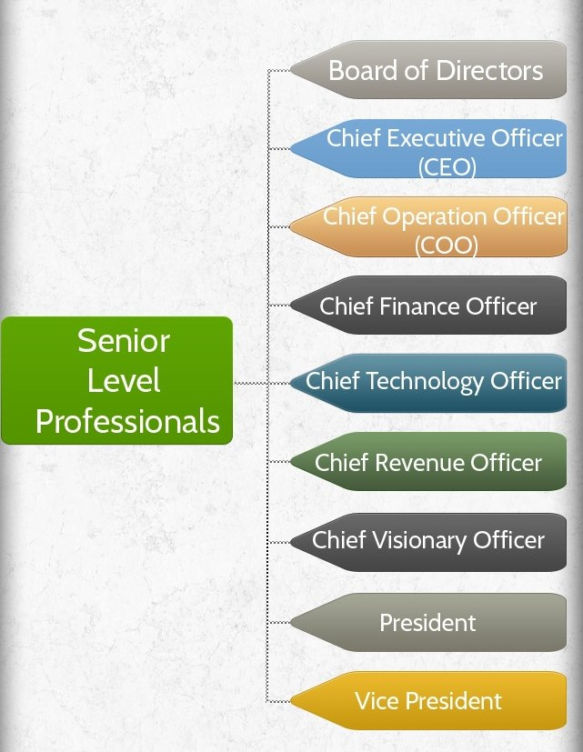
POST HIERERCHY

Slide 29
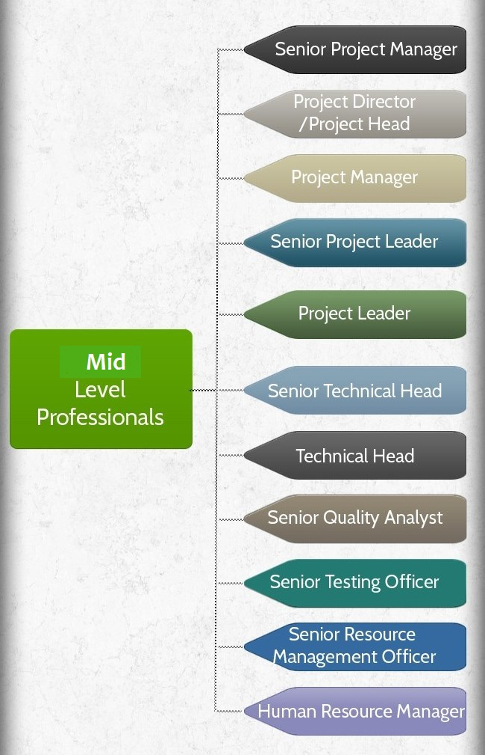
LEVEL 2

Slide 30
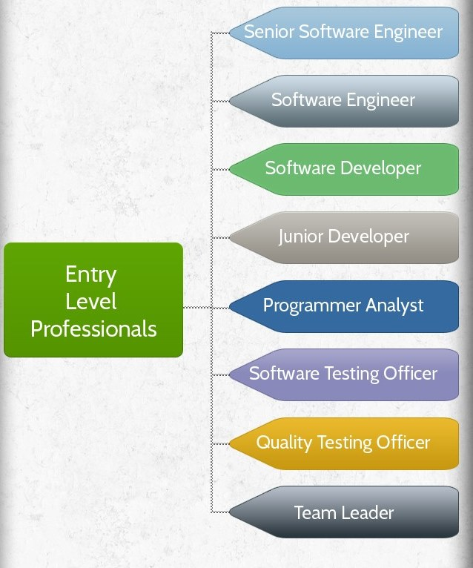
LEVEL 3

Slide 32

MOTO
Build and implemented the model
Calculated profit
Made it viable for
customer’s consumption
Ready for public use

Slide 33
Limitations

Slide 34
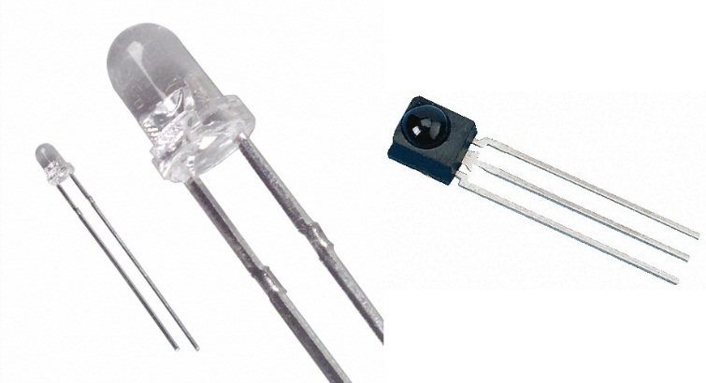
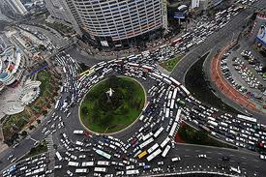
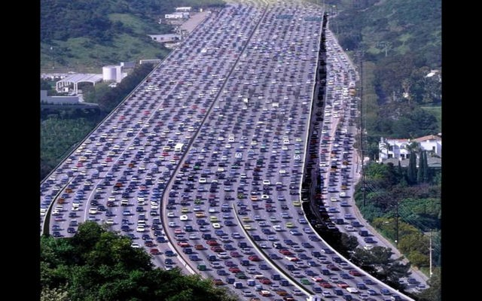
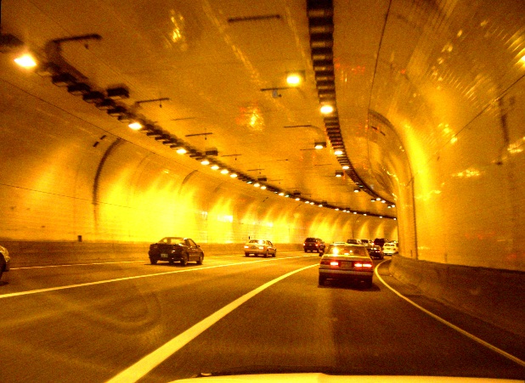
IR range + accuracy (TSOP)
Multi-lanes & multi-crossings
GPS not working within caves & tunnels

Slide 35
Thank You

